Slide 1

Diving into NestJS: Building Enterprise Web Applications
COURSE - - - NestJS – NodeJS Framework

Slide 2

About me
Just quick stuff
Name: Bektemirov Aziz
Position: Middle Software Engineer at Vention
Education: BS in MIS
Tech Stack: Frontend (React.js, Next.js), Backend (Node.js, Express.js, Nest.js)
Motto: Anything that can be written in JavaScript, would be written in JavaScript

Slide 3
Agenda for today
Why NestJS
Dependency Injection & Decorators
Core NestJS Entities: Modules, Controllers, Providers
Additional NestJS Entities: Guards, Filters, Interceptors, Pipes
Nest CLI
Data validation & Databases
Auth in NestJS

Slide 4





Looking at Node.js World

Slide 5

Looking at Node.js World - Trends
ExpressJS is dominating
Notes:
https://npmtrends.com/express-vs-fastify-vs-hapi-vs-hono-vs-koa

Slide 6
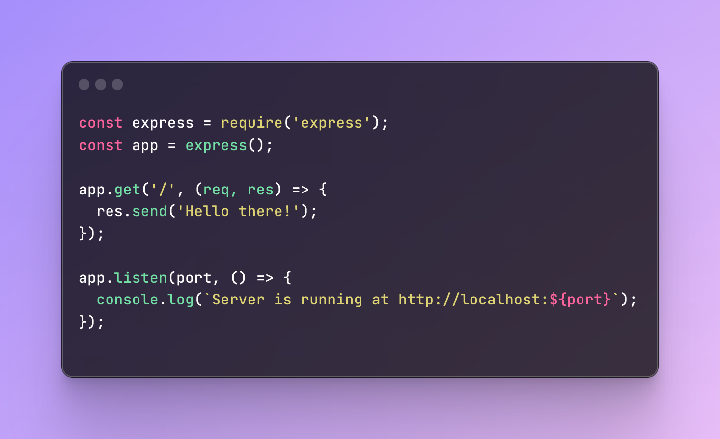
Looking at Node.js World - ExpressJS
ExpressJS is easy, right?
Minimalistic
No hassle
Flexible
Request -> Response

Slide 7




Looking at Node.js World - Drawbacks of ExpressJS
Lack of structure
Complex Configuration
Limited build-in features
Boilerplate code

Slide 8

NestJS solves these issues!
Build on a top of ExpressJS/Fastify
Structured architecture
Build-in dependency injection
Modularity
Testing
Scalability

Slide 9






Who uses NestJS?

Slide 10
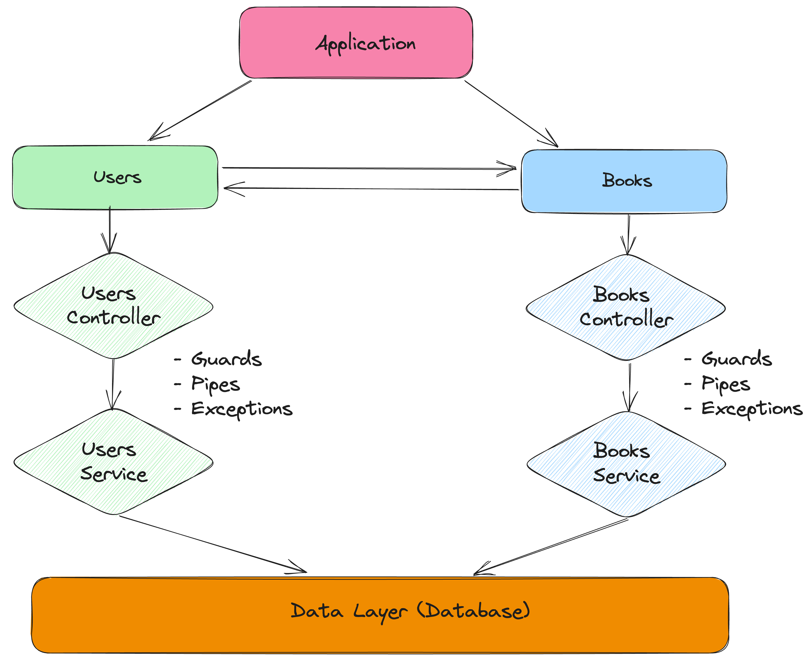
NestJS Architecture

Slide 11
NestJS Architecture - Entities
Module
Controller
Provider
Guard
Pipe
Filter

Slide 12

Dependency Injection
Dependency injection is a programming design pattern where the components of a system receive their dependencies from an external entity rather than creating them internally.
- From technical perspective

Slide 13

Dependency Injection - What?
Yeah, I am old

Slide 14
Dependency Injection - What?
“Dependency Injection” is an overly-complex term for an extremely simple concept

Slide 15
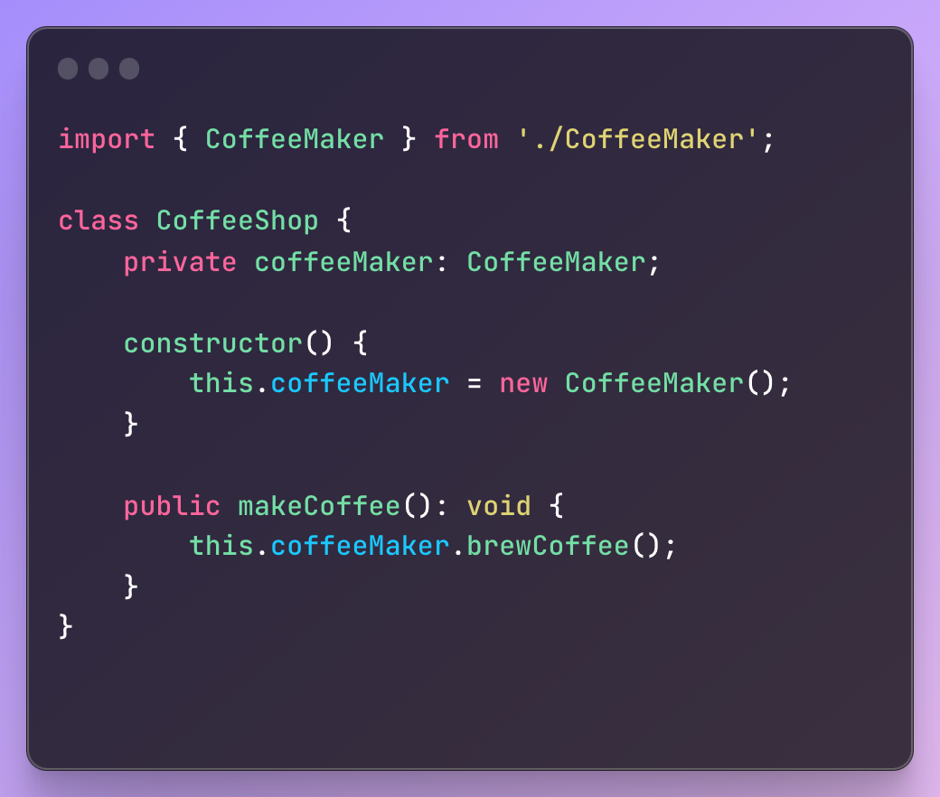
Dependency Injection - What is Dependency?
This is not an example of dependency injection

Slide 16
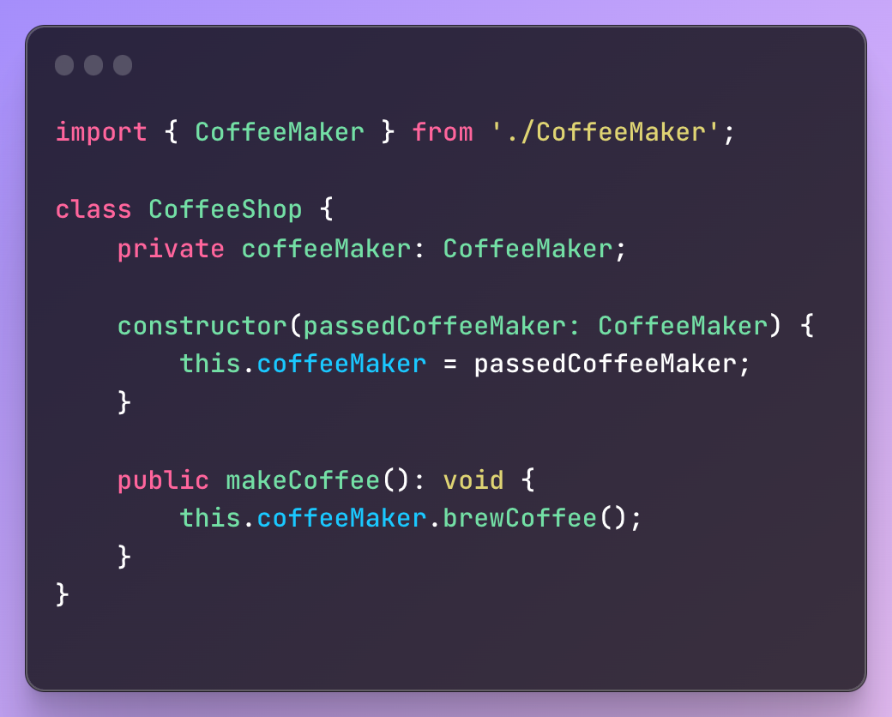
Dependency Injection - What is Dependency?
This is an example of dependency injection
Notes:
Example of the simplest DI

Slide 17
Dependency Injection - What is Dependency?

Slide 18

Dependency Injection - Definition
Dependency Injection is like giving an object the things it needs (dependencies) instead of forcing it to create or find them by itself.

Slide 19
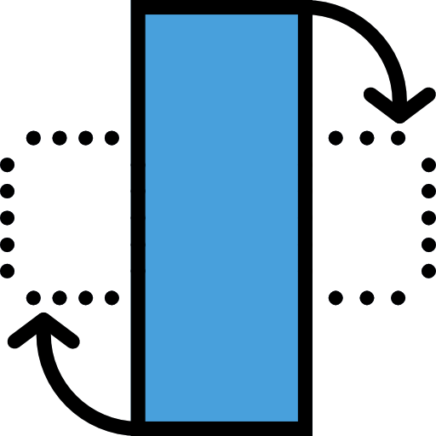
Dependency Injection - IoC
Inversion of control (IoC) is a design pattern (or principle) where the control flow of a program is inverted or "flipped" compared to traditional programming.

Slide 20



Dependency Injection - IoC
You drive the car
You use taxi service

Slide 21

Dependency Injection - IoC
IoC Container is a software component responsible for managing the instantiation, lifecycle, and dependencies of objects within an application

Slide 22
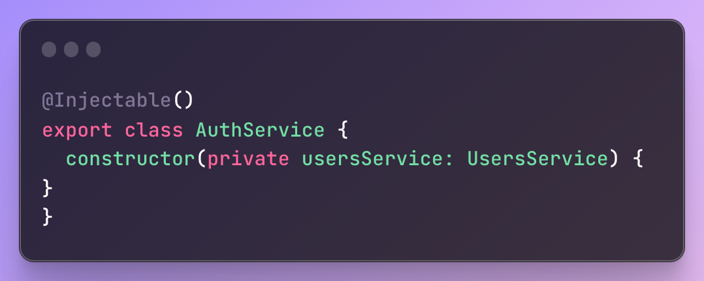
Dependency Injection - NestJS
AuthService is injectable and it needs UsersService

Slide 23
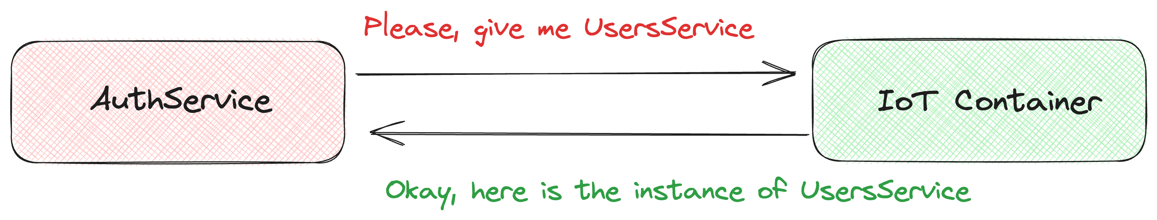
Dependency Injection - NestJS

Slide 24

Benefits of Dependency Injection
Modularity
Maintainability
Testability
Readability
Scalability

Slide 25
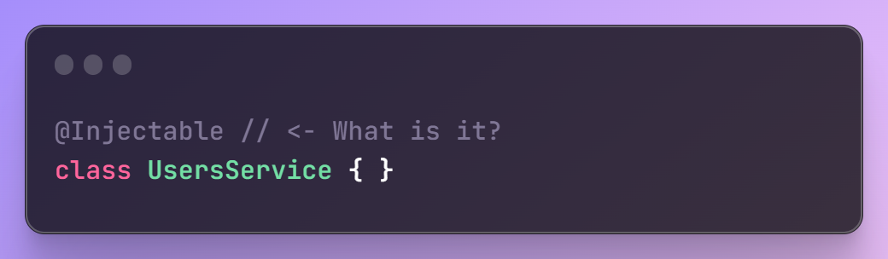
What is it?
@Injectable is a decorator

Slide 26

Decorators - Concept
Decorate - add something to an object or place, especially to make it more attractive
- Cambridge Dictionary

Slide 27

Decorators - Definition
A decorator is a special function, that allows to attach additional behavior or metadata to classes, methods, properties, or parameters, enhancing their functionality or providing customizations.

Slide 28

Module
Module is fundamental building block that encapsulates a set of related components, such as controllers, providers, and other modules, to organize and structure the application.

Slide 29
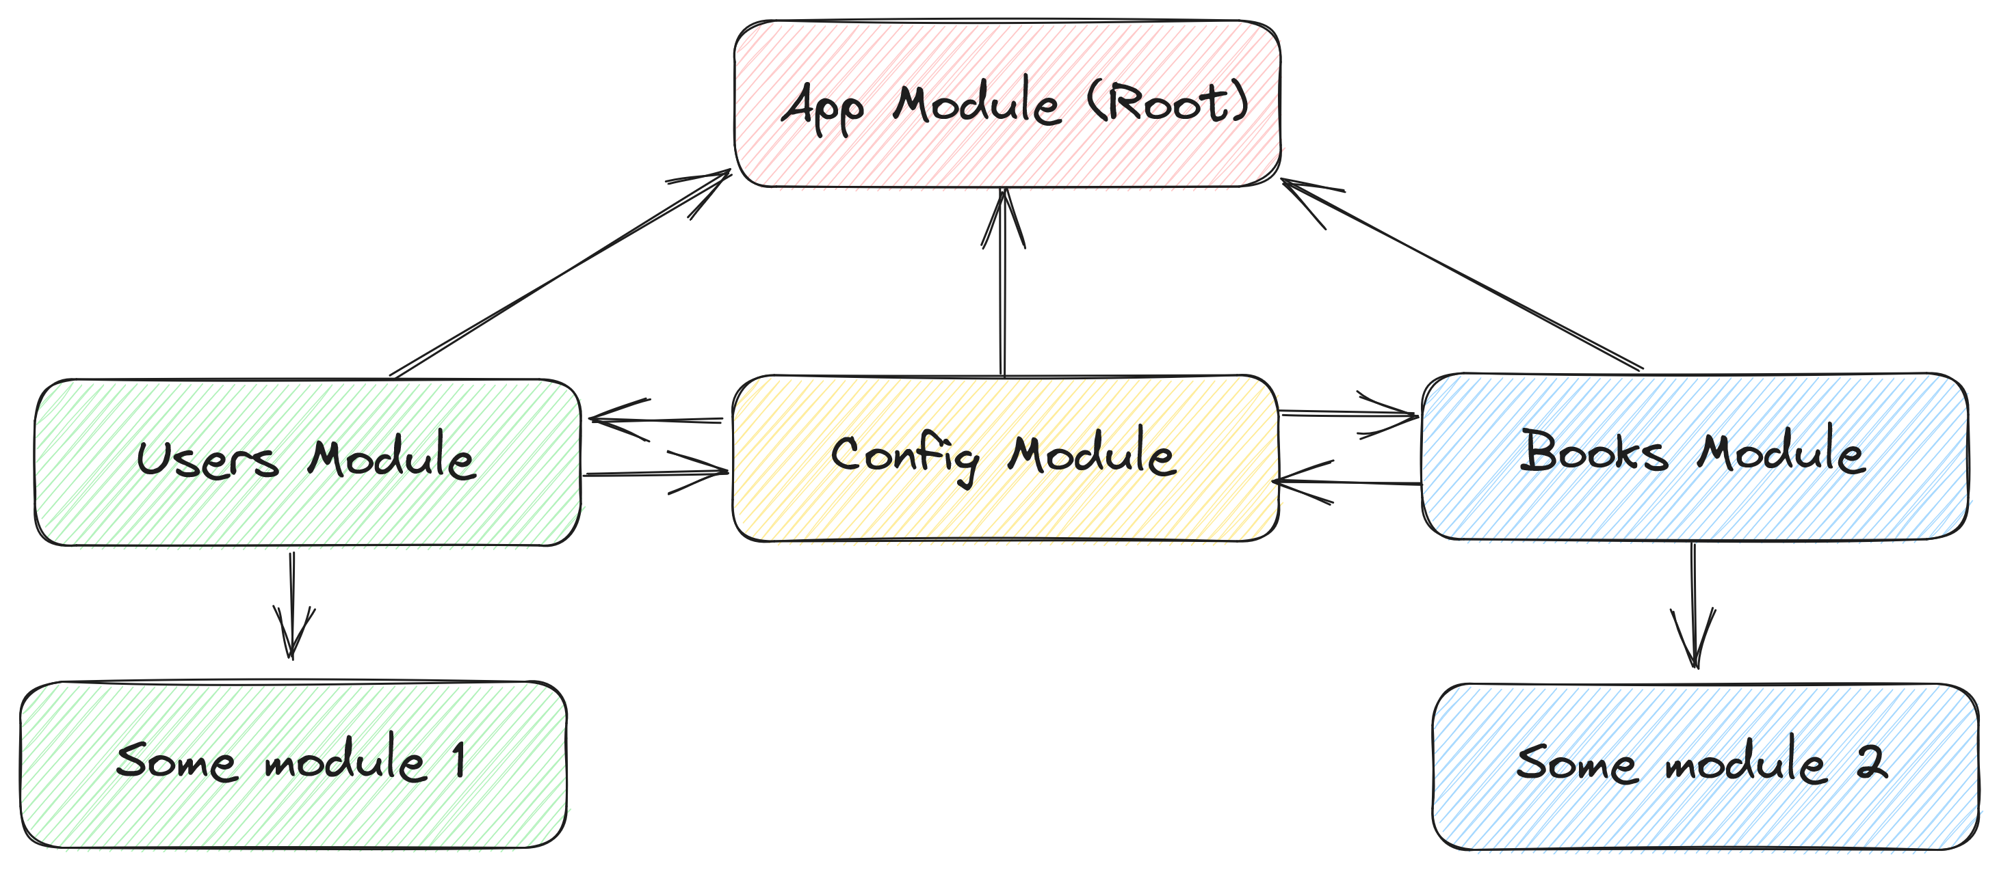
Module

Slide 30
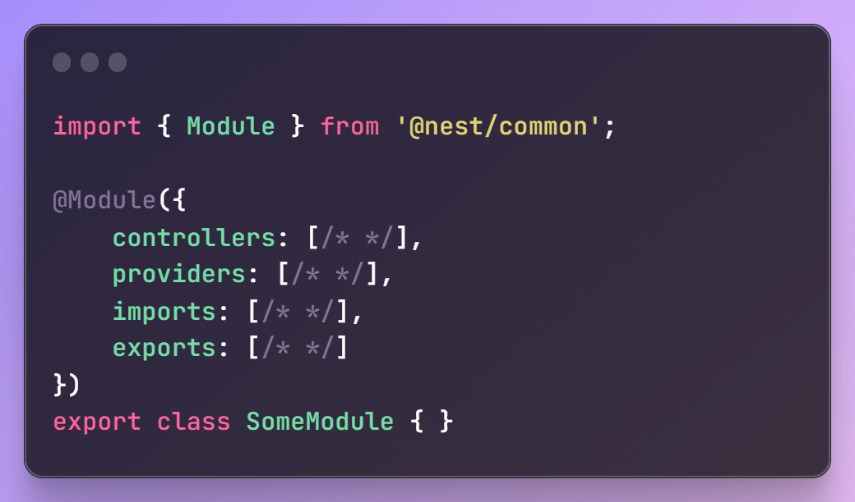
Module
Controllers: List of controllers for this module
Providers: Injectable entities that would be shared across the whole module
Imports: Imported modules that exports providers that are needed for this module
Exports: Exported providers that can be used in other modules, when this module is imported

Slide 31

Controller
Controller is an entity that is responsible for handling requests and returning responses.

Slide 32
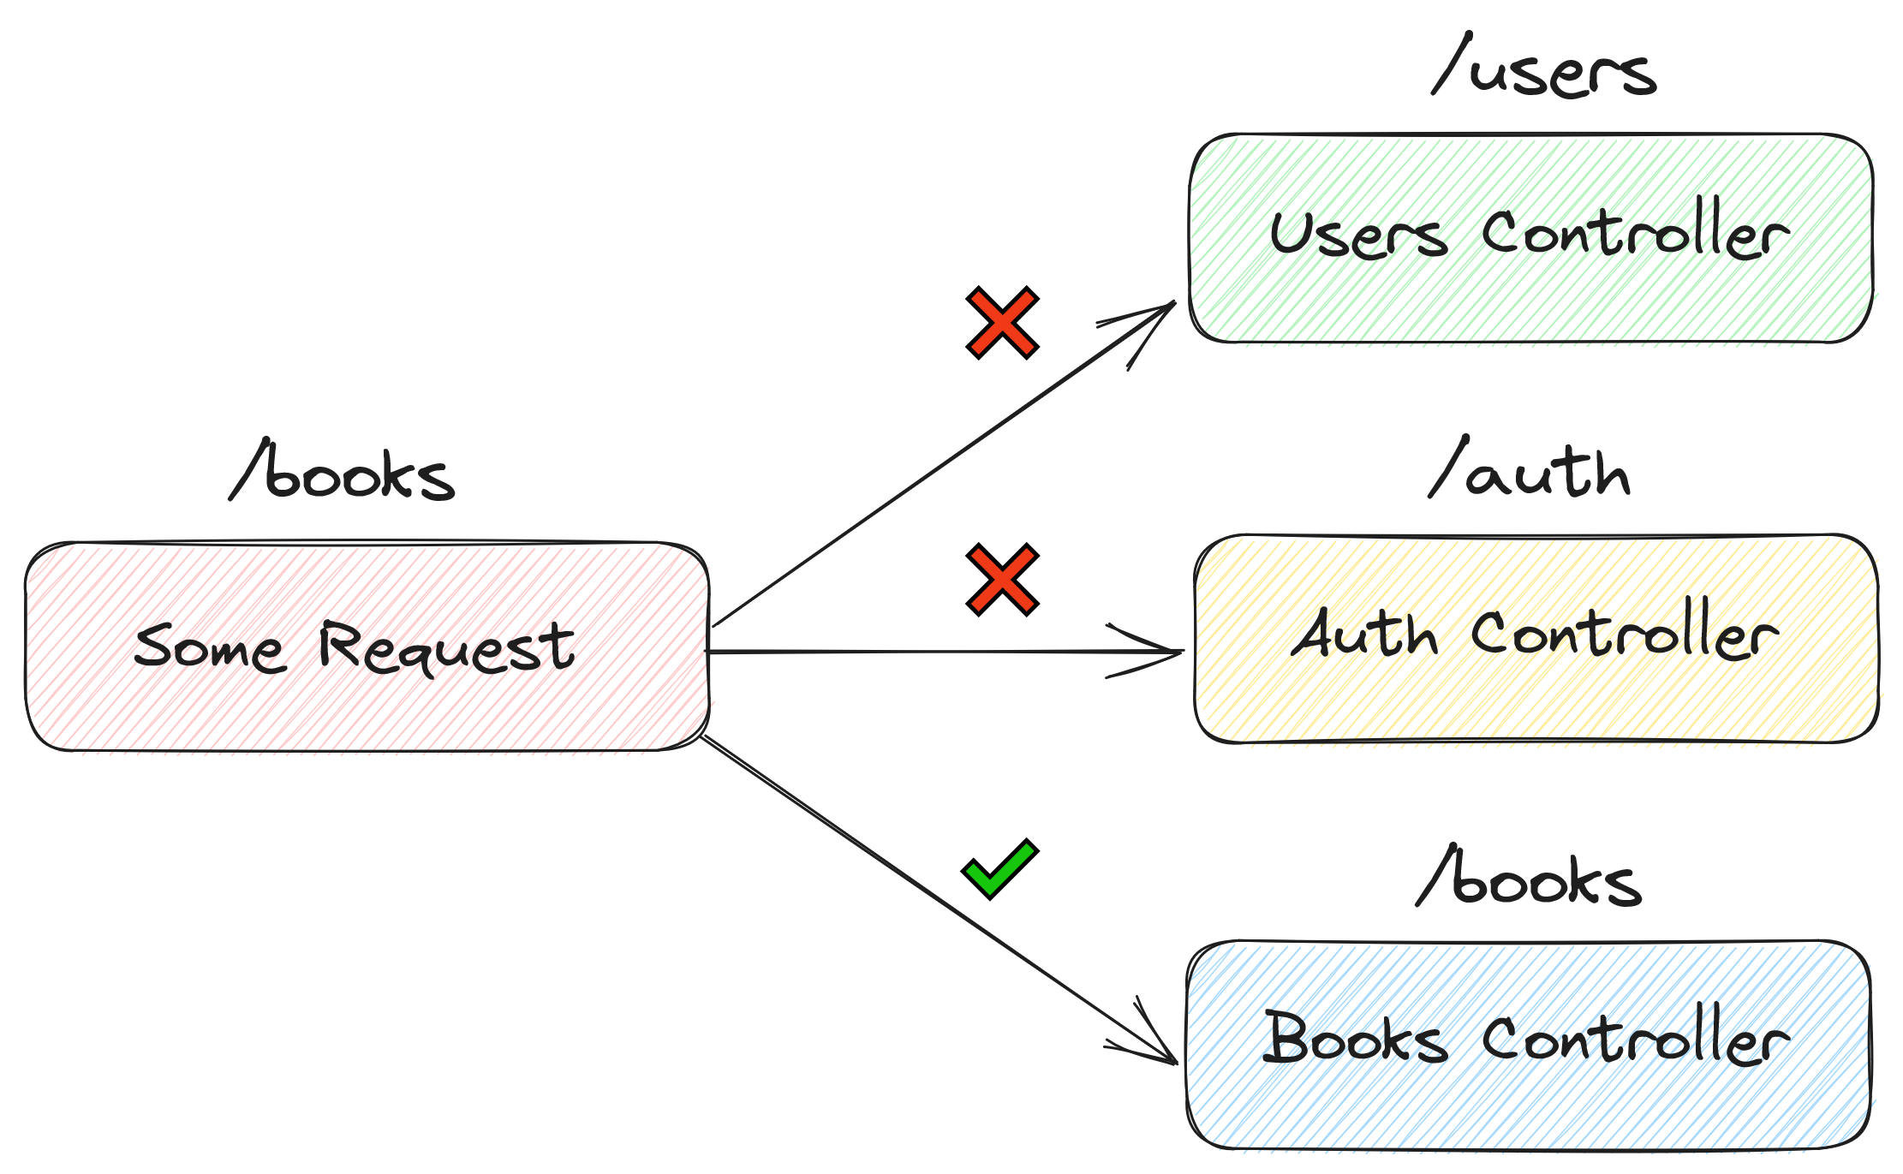
Controller

Slide 33
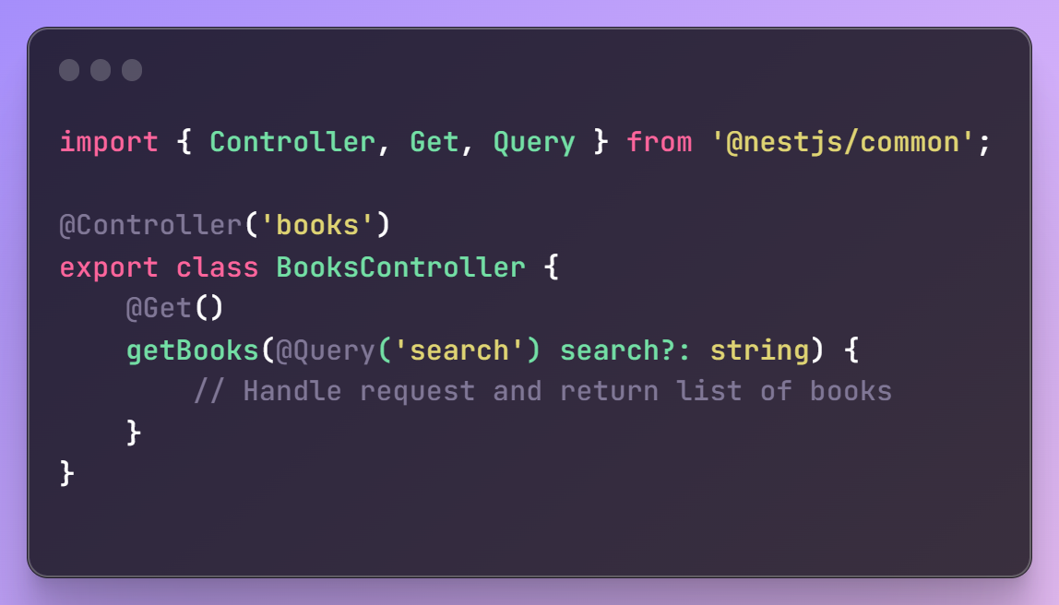
Controller
Uses @Controller decorator on class
Uses @Get, @Post, etc. decorators to indicate HTTP method and URL (optional)
Can access request directly via @Req decorator or using special NestJS decorators (@Query, @Param, @Body, etc.)
Can validate incoming body via DTO

Slide 34

Provider
Provider is an entity that can be injectable in other providers, modules or controllers. Providers can be anything: classes, objects, primitive values and they can act as services, repositories and so on

Slide 35
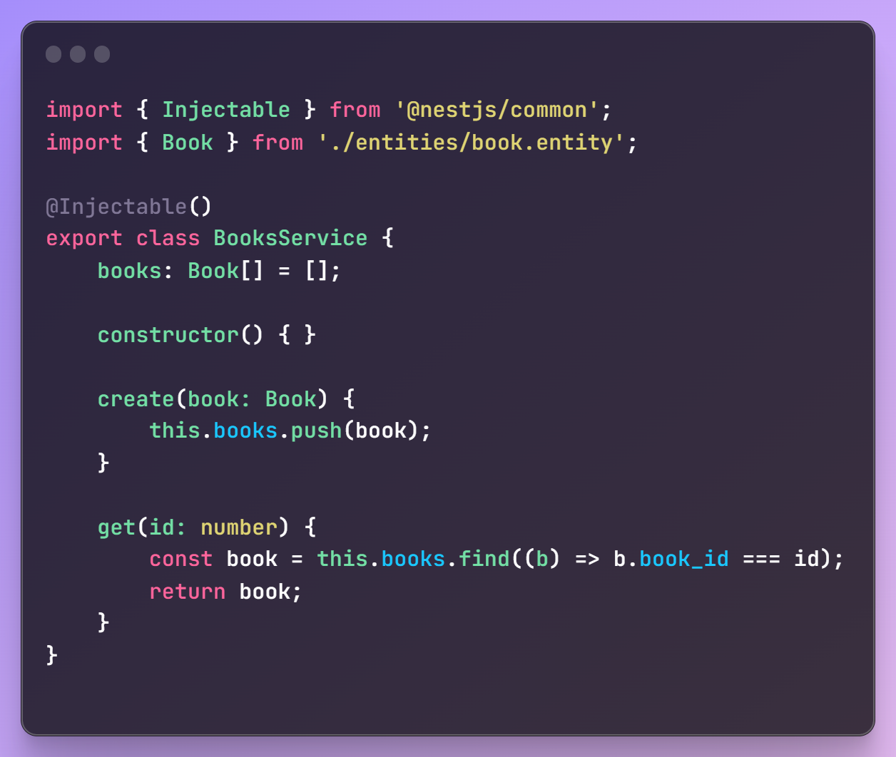
Provider - Service
Encapsulates business logic
Gives separation of concerns
Controller is lightweight, since everything is done in service
Can require other services/providers

Slide 36
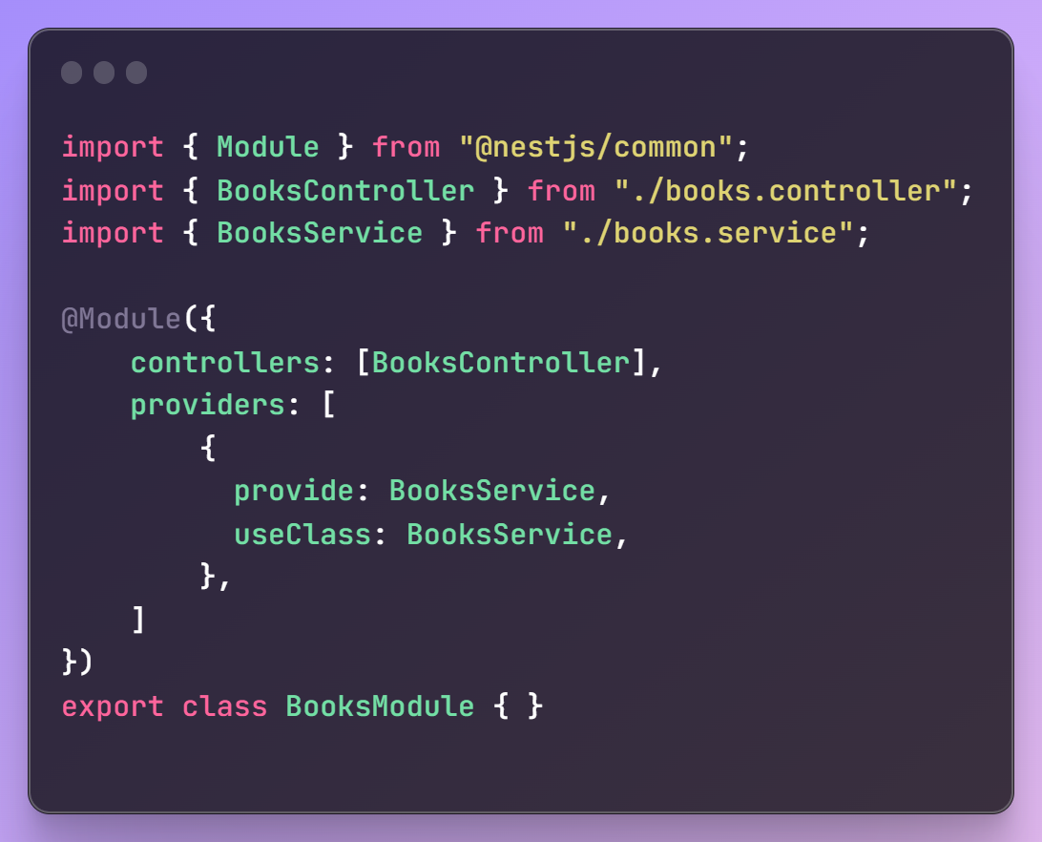
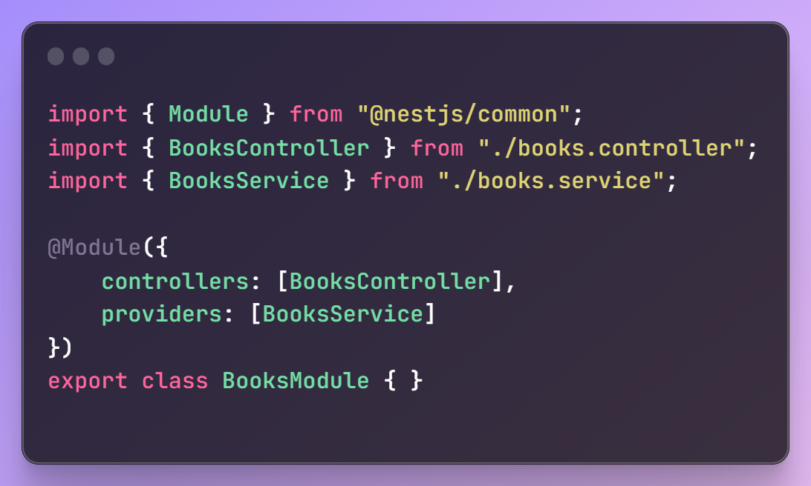
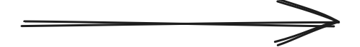
Provider - Custom Providers
“Behind the scenes”

Slide 37
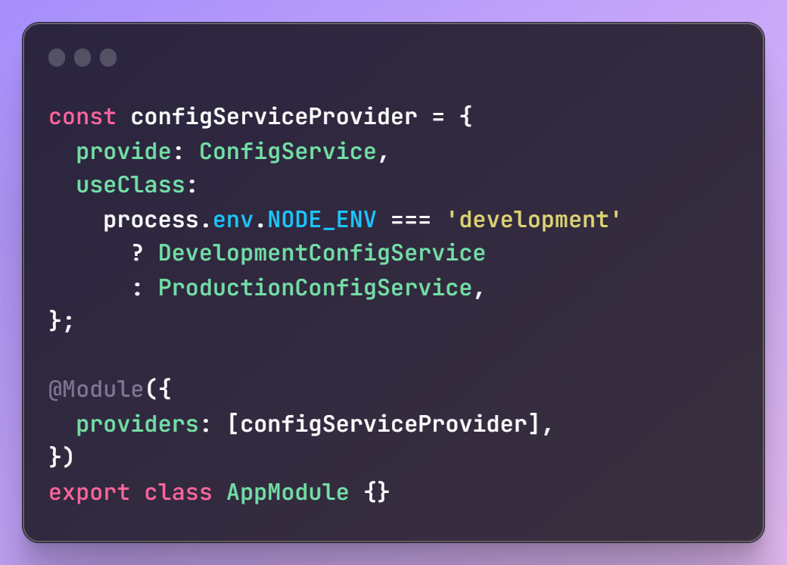
Provider - useClass
useClass allows to dynamically determine which class would be used for the given provider

Slide 38
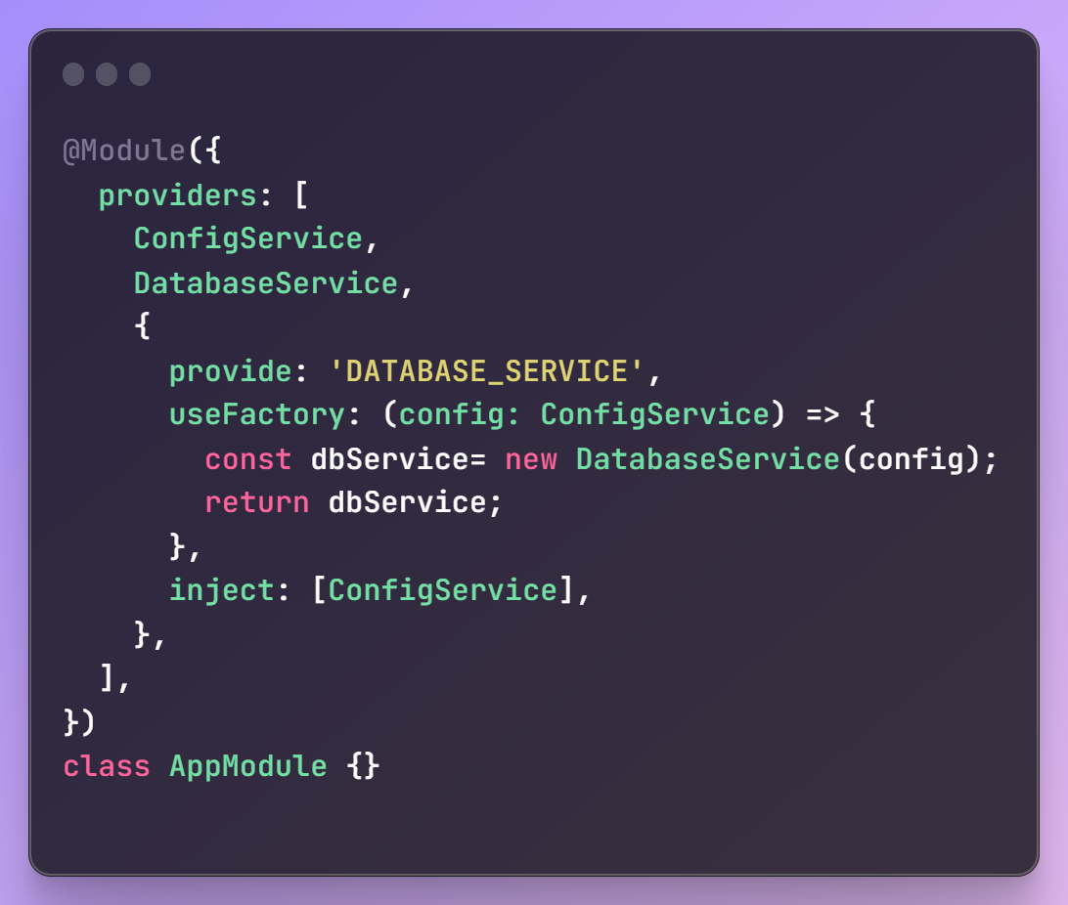
Provider - useFactory
useFactory allows to dynamically create providers in the runtime

Slide 39
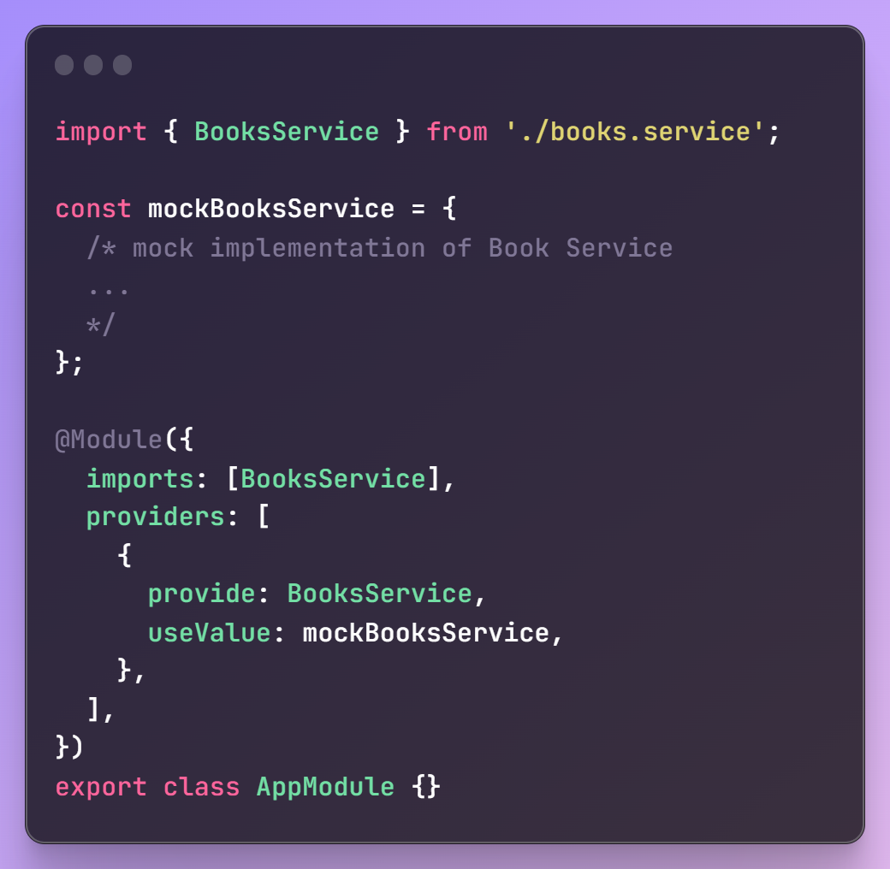
Provider - useValue
useValue allows to inject some constant values (for example, to replace a real implantation with mock one) or inject non-class- based values into the provider.

Slide 40

Any questions?
Thank you very much!

